Slide 1
EDA - Exploratory Data Analysis

Slide 2
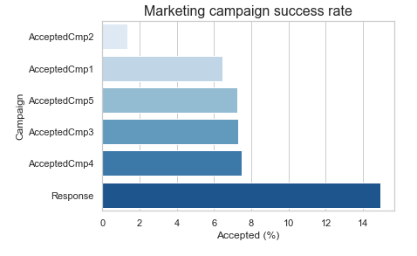

Slide 3
What does the average customer look like for this company?
Basic demographics: The average customer is...
Born in 1969
Became a customer in 2013
Has an income of roughly $52,000 per year
Has 1 dependent (roughly equally split between kids or teens)
Made a purchase from our company in the last 49 days

Slide 4
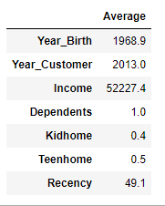

Slide 5
Which products are performing best?
The average customer spent... $25-50 on Fruits, Sweets, Fish, or Gold products
Over $160 on Meat products Over $300 on Wines Over $600 total
Products performing best:
Wines
Followed by meats

Slide 6
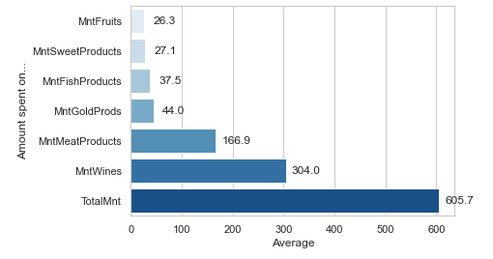
Average amount spent

Slide 7
Which channels are underperforming?
Channels: The average customer...
Accepted less than 1 advertising campaign
Made 2 deals purchases, 2 catalog purchases, 4 web purchases, and 5 store purchases
Averaged 14 total purchases
Visited the website 5 times
Underperforming channels:
Advertising campaigns
Followed by deals, and catalog

Slide 8
